Slide 1
Module 3: Ethical Issues and Privacy
ILO BE – Management Information System
Rina Bora
Assistant Professor
Dept. of Computer Engineering,
SIES Graduate School of Technology
1

Slide 2
Module 3: Ethical Issues and Privacy
Kelly Rainer, Brad Prince, “Management Information Systems”,
Wiley.
Rainer & Cegielski,”Introduction to Information Systems- Supporting & Transforming Business”, 3rd edition, Wiley.
2

Slide 3
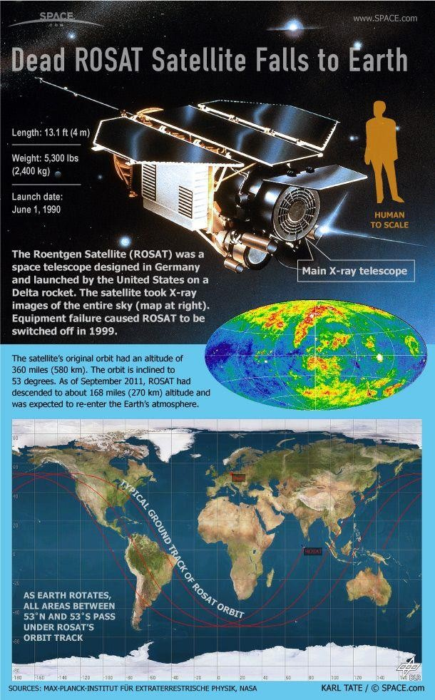
Introduction
In 1998 when hackers took control of the U.S.-German ROSAT X-ray satellite.
Hacking into computers at the Goddard Space Flight Center in Maryland.
Instructed the satellite to aim its solar panels directly at the sun.
This effectively fried its batteries and rendered the satellite useless.
https://cdn.mos.cms.futurecdn.net/m67APYunbhKcsLvNwhPezh-970-80.jpg
3

Slide 4
Introduction
In 2002, attackers penetrated the computer network at the Marshali Space Flight Center and stole secret data on rocket engine designs.
In 2004, attackers compromised computers at NASA’s Ames
Research Center in Silicon Valley. The attackers had apparently cracked an employee’s password at the Goddard Center in Maryland used it to hack into the Ames Research Center.
In April 2005, an intruder installed a malignant software program inside the digital network of NASA’s Kennedy Space Center and gathered data from computers in the Vehicle Assembly Building where the Space Shuttle is maintained.
4

Slide 5
Introduction
The lessons learned
The security breaches at NASA address the three major issues :
Ethics, Privacy, and Security.
Each of these issues is closely related to IT and raises significant questions.
5

Slide 6
Ethical Issues
Ethical Frameworks
There are many sources for ethical standards. The four major standards are as below.
The utilitarian approach- An ethical action provides the most good or does the least harm to customers, employees, shareholders, the community, and the physical environment.
The rights approach- An ethical action best protects and respects the moral rights of the of customers, employees, shareholders, business partners, and even competitors. (Moral rights - the rights to make one’s own choices about what kind of life to lead, to be told the truth, not to be injured, and to enjoy a degree of privacy)
6

Slide 7
Ethical Issues
Ethical Frameworks
The fairness approach- The ethical actions treat all human beings equally, or, if unequally, then fairly, based on some defensible standard. For example, most people might believe it is fair to pay people.
The common good approach- Believes that Respect and compassion for all others is the basis for ethical actions. It emphasizes the common conditions like a system of laws, effective police and fire departments, healthcare, a public educational system, and even public recreation areas, which are important to the welfare of everyone.
7

Slide 8
Ethical Issues
Ethical Frameworks
Combine these four standards, a general framework for ethics (or ethical decision making) is developed. This framework consists of five steps:
1. Recognize an ethical issue:
Could this decision or situation damage someone or some group? Does this decision involve a choice between a good and a bad alternative? Does this issue involve more than simply legal considerations? If so, then in what way?
8

Slide 9
Ethical Issues
Ethical Frameworks
Get the facts:
What are the relevant facts of the situation? Do I have sufficient
information to make a decision? Which individuals and/or groups have an important stake in the outcome? Have I consulted all relevant persons and groups?
Evaluate alternative actions:
Which option will produce the most good and do the least harm? Which option best respects the rights of all stakeholders? Which option treats people equally or proportionately? Which option best serves the community as a whole, and not just some members?
9

Slide 10
Ethical Issues
Ethical Frameworks
Make a decision and test it:
Considering all the approaches, which option best addresses the
situation?
Act and reflect on the outcome of your decision:
How can I implement my decision with the greatest care and attention to the concerns of all stakeholders? How did my decision turn out, and what did I learn from this specific situation?
10

Slide 11
Ethical Issues
Ethics
Fundamental principles of ethics include
Responsibility means that you accept the consequences of your
decisions and actions.
Accountability refers to determining who is responsible for actions
that were taken.
Liability is a legal concept that gives individuals the right to recover the damages done to them by other individuals, organizations, or systems.
What is unethical is not necessarily illegal.
Ethical decisions may have serious consequences for individuals,
organizations, or society at large.
11

Slide 12
Ethical Issues
Ethics in the Corporate Environment
Ethics refers to the principles of right and wrong that individuals use to make choices to guide their behaviors.
Many companies and professional organizations develop their own codes of ethics.
A code of ethics is a collection of principles that is intended to guide decision making by members of the organization.
12

Slide 13
Ethical Issues
Ethics
Computing processing power doubles about every 15-18 months- organizations are more dependent than ever before on their information systems.
Increasing amounts of data can be stored at decreasing cost - organizations can store more data on individuals for longer amounts of time.
Computer networks- enable organizations to collect, integrate, and distribute enormous amounts of information on individuals, groups, and institutions.
Ethical problems are arising about the appropriate use of customer
information, personal privacy, and the protection of intellectual property.

Slide 14
Ethical Issues
Ethics and Information Technology
All employees have a responsibility to encourage ethical uses of information and Information Technology.
Many business decisions may have an ethical dimension.
Should organizations monitor employees’ Web surfing and e-mail?
Should organizations sell customer information to other companies?
Should organizations audit employees’ computers for unauthorized software or illegally downloaded music or video files?

Slide 15
Ethical Issues
Ethics and Information Technology
Ethical Issues
A variety of ethical issues exists due to the diversity and ever-expanding use of
IT applications.
Four general categories: privacy, accuracy, property, and accessibility.
Privacy issues involve collecting, storing, and disseminating information about individuals.
Accuracy issues involve the authenticity, fidelity, and accuracy of information that is collected and processed.
Property issues involve the ownership and value of information.
Accessibility issues revolve around who should have access to information
and whether they should have to pay for this access.

Slide 16
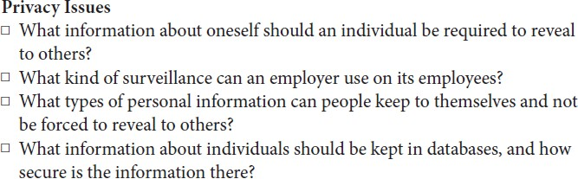
Ethical Issues
Ethics and Information Technology
A Framework for Ethical Issues

Slide 17
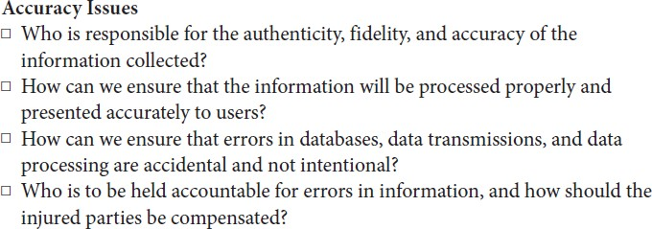
Ethical Issues
Ethics and Information Technology
A Framework for Ethical Issues

Slide 18
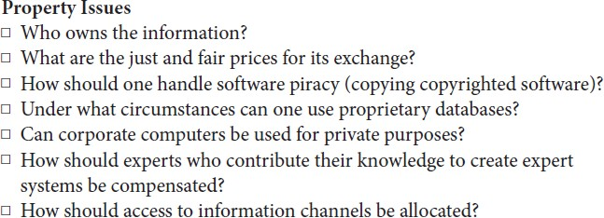
Ethical Issues
Ethics and Information Technology
A Framework for Ethical Issues

Slide 19
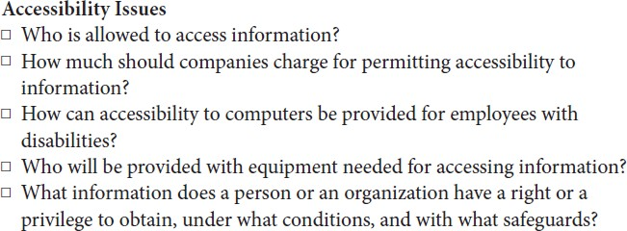
Ethical Issues
Ethics and Information Technology
A Framework for Ethical Issues

Slide 20
Thank You!

